Slide 1
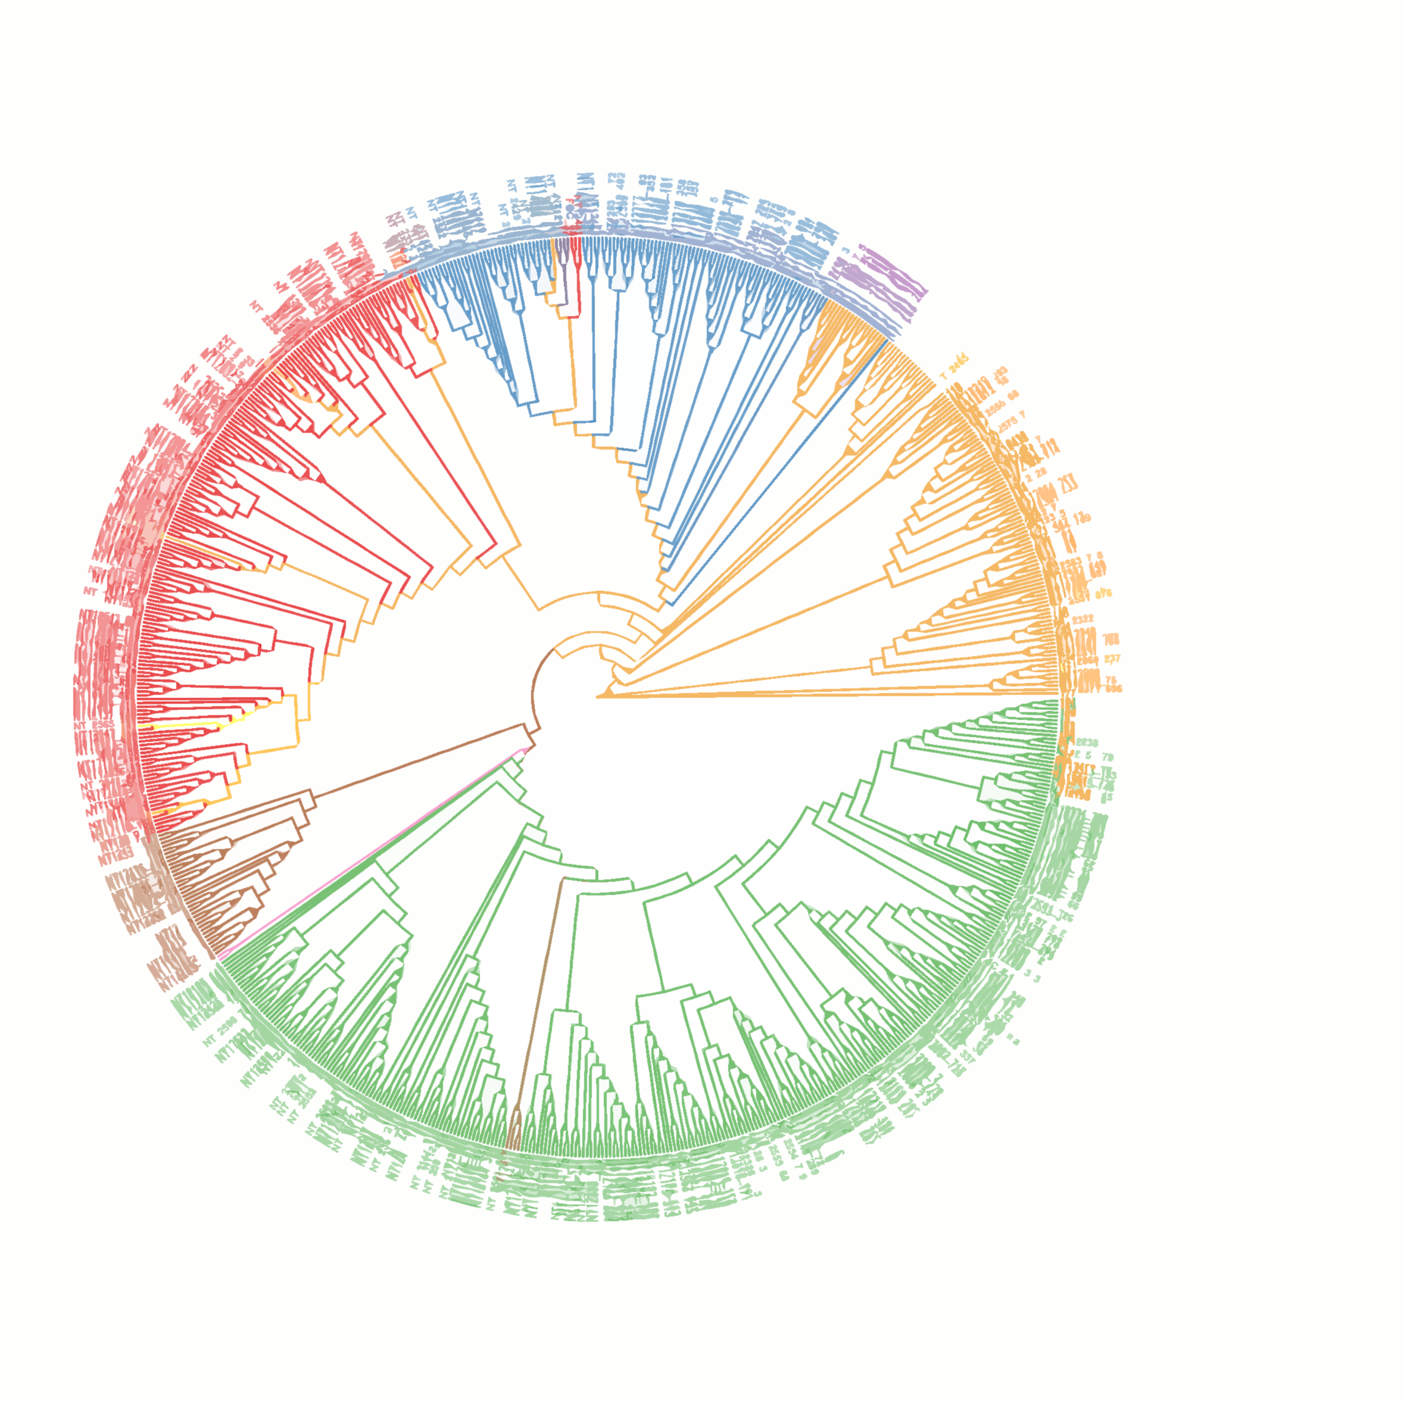



Microbiome in drug response: navigating the genetic landscape of the E. coli pangenome
Daniel Martínez Martínez
Host-Microbe Co-Metabolism lab
UKPGx2022 - 15/06/2022

Slide 2
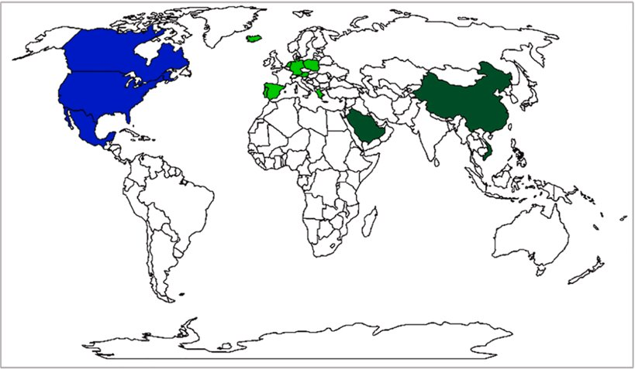
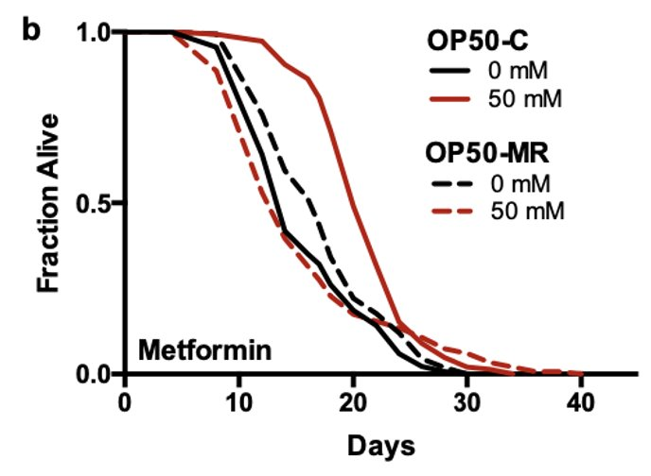
Introduction – Metformin effects on host physiology are influenced by gut microbes ​
Metformin is an interesting drug
Type-2-diabetes drug​
Causes microbial composition shift in patients (Forslund et al. 2015, Wu et al. 2017)​
↑ Escherichia coli​
Widespread usage > high doses​
Longevity!​
​
Metformin increases Caenorhabditis elegans lifespan​
Dose- and Microbe-dependent (Cabreiro et al. 2013)​
Metformin effects in C. elegans are microbe and nutrient dependent (Cabreiro et al. 2013, Pryor et al. 2019)​
Dietary restriction ​
Crp = transcriptional regulator of metformin effects in bacteria
Ambrosio-Albuquerque et al. 2021​
MR = Metformin Resistant​
Pryor & Norvaias et al. 2019

Slide 3
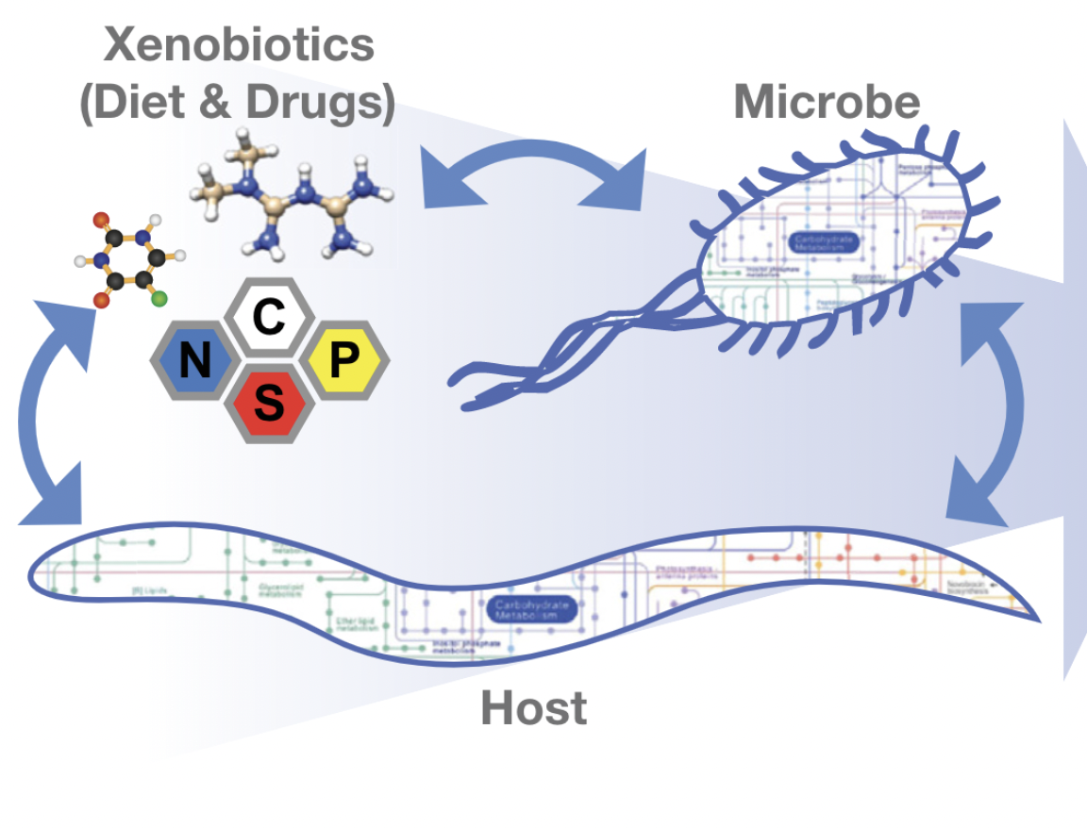
Introduction – bacteria respond to drugs in different ways
Microbes can​
uptake drugs (Spanogiannopoulos et al 2016; Zimmermann et al 2019)​
chemically change its structure (Maier et al 2018)​
influence drug efficacy (Scott et al 2017; Pryor et al 2019)​
Long term drug treatment or extensive drug exposure​
Antibiotics (Maier et al., 2021)​
Antipsychotics (Yuan et al., 2018)​
Anti-diabetic drugs > metformin (Forslund et al 2015; Pryor et al. 2019)​
​
Effects on the host can be highly variable!
Norvaias & Cabreiro, 2018
Notes:
Why is it important to study microbe-host-drug interactions
Drugs are an important part our daily lives at this moment, and microbes interact with them in different ways depending on many factors

Slide 4
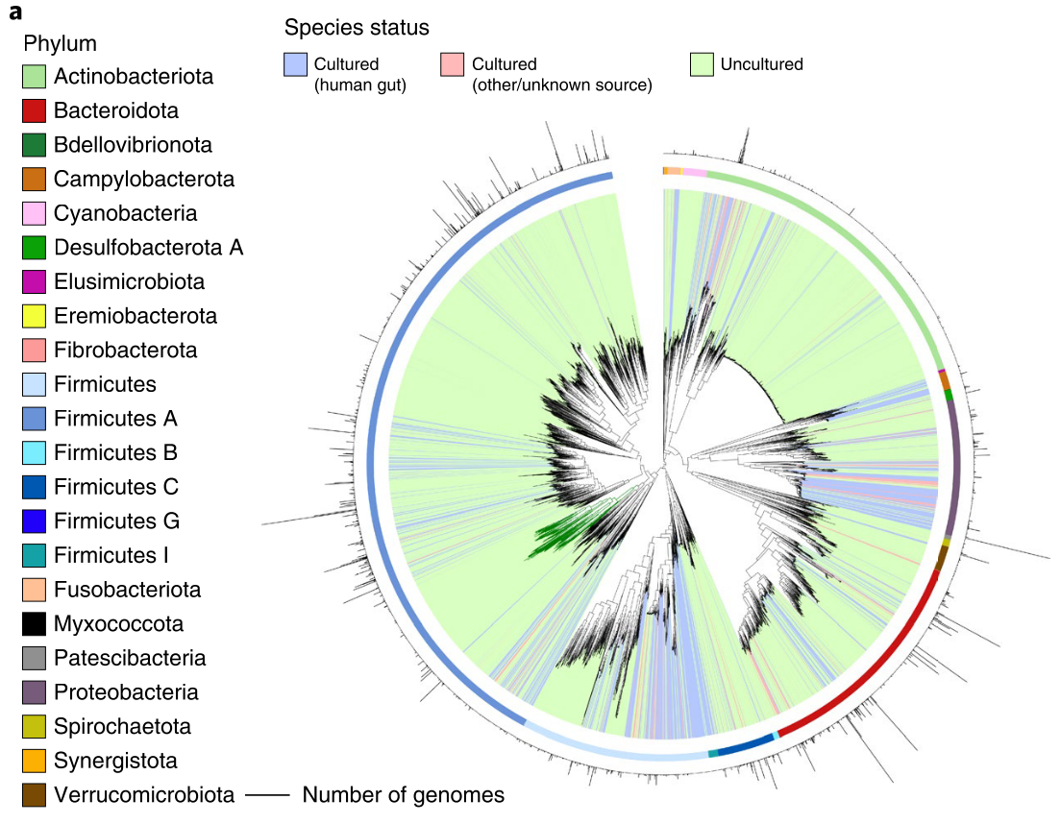
Introduction – increasing the resolution in the microbiome
~ 4500 microbial species
~ 200K non-redundant genomes
There is a vast and unexplored diversity within species
Almeida et al., 2020
Notes:
Microbiome studies are increasingly more accurate at capturing the ecological complexity of the microbial populations. In a recent paper by Alex Almeida, they were able to generate a

Slide 5
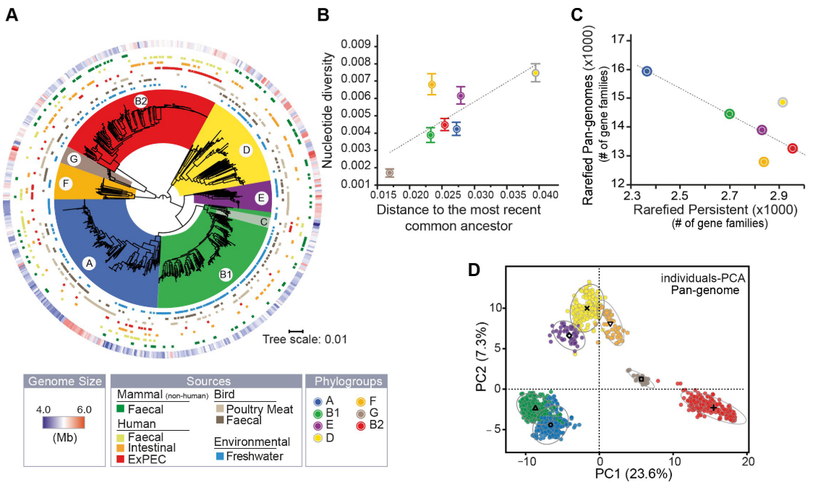
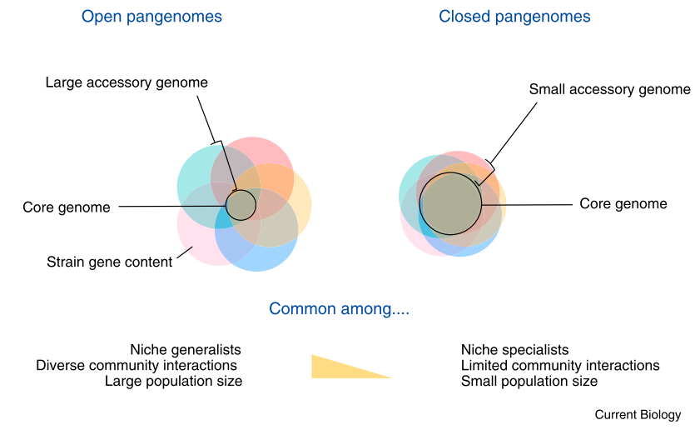
Introduction –the concept of pangenome
To study the diversity within species -> pangenome
E. coli pangenome
Brockhurst et al., 2019
Touchon et al., 2020
Notes:
The concept of pangenome is quite recent, and is defined as the set of all the genes present in a given species and can be subdivided into the accessory genome, present in only some of the genomes, and the core genome, present in all the genomes. Pangenomes are dynamic systems that are in constant evolution
What is interesting is that genes within a pangenome are either common or rare in the population
As an example that falls very close to the topic of this talk, Marie Touchon and colleagues explored the pangenome of more than 1000 genomes from E. coli and how it evolved recently.

Slide 6
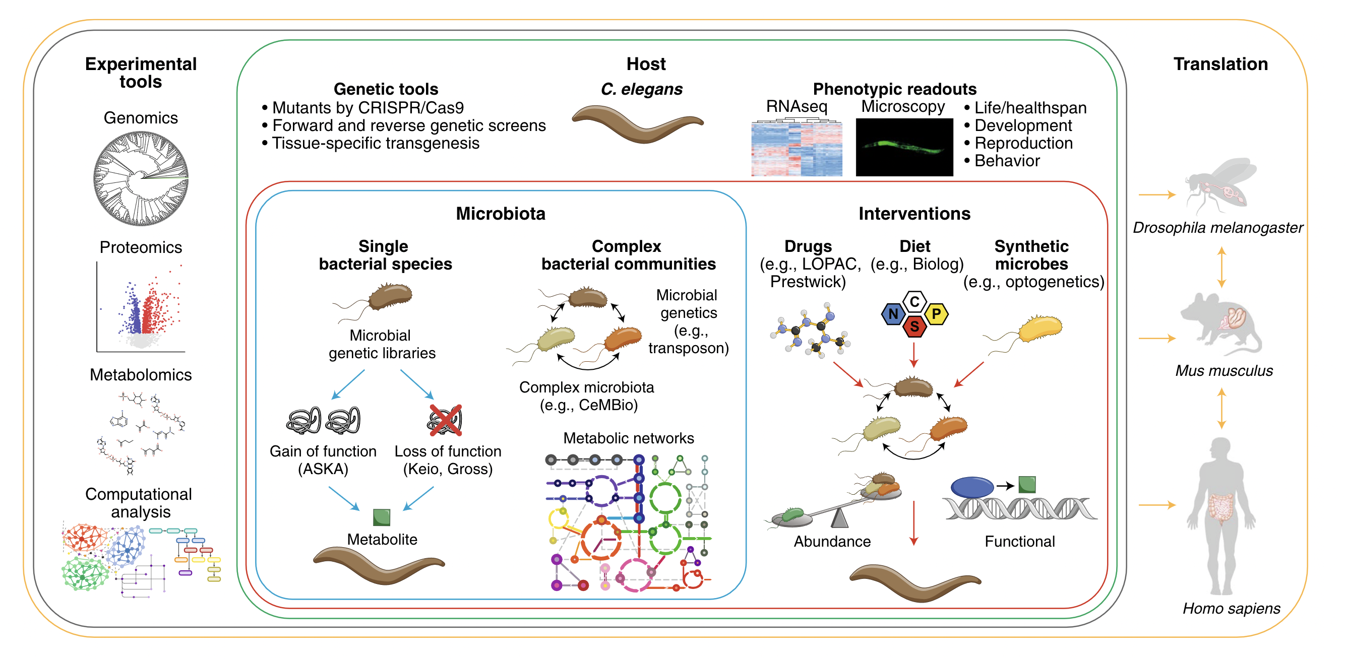
Introduction – our Lab’s workflow
Martinez-Martinez, Backes and Cabreiro, 2021
Notes:
Important to say that we use the worm as an entry point for discoveries that can be applied to closer organisms and for us.

Slide 7
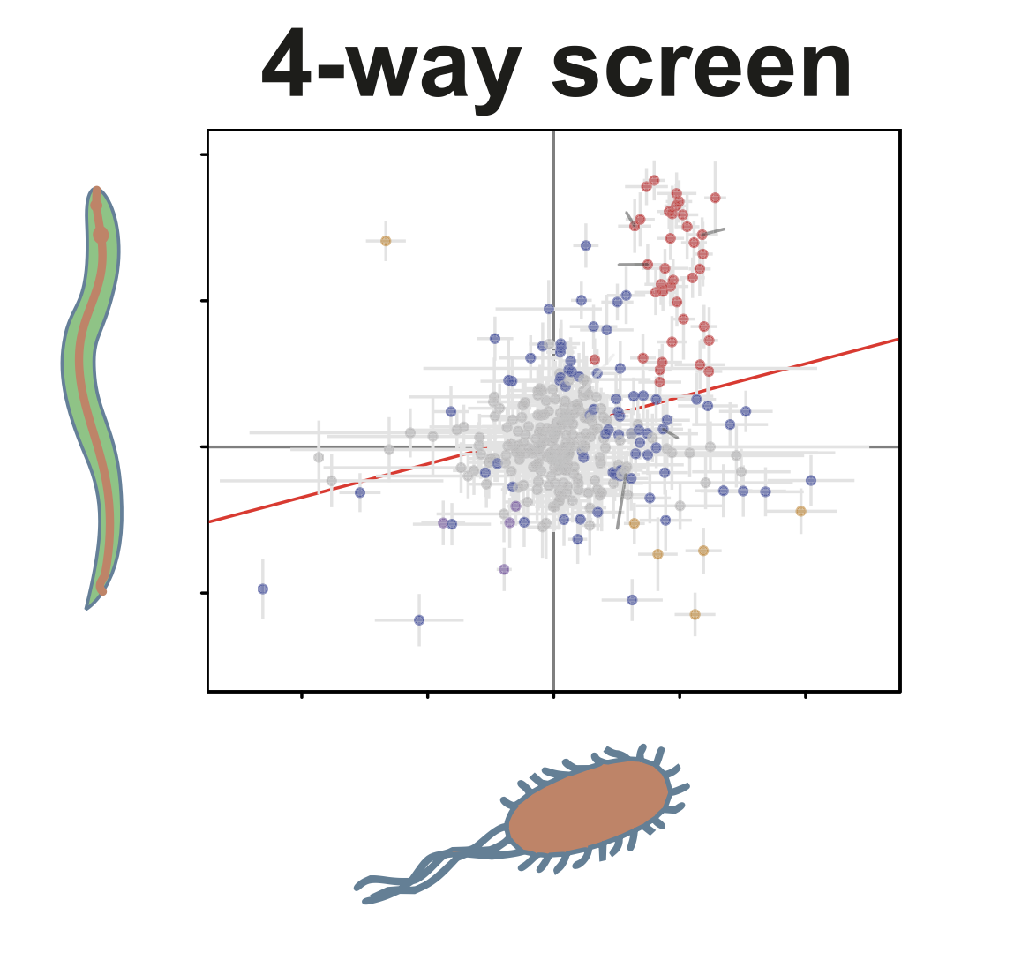
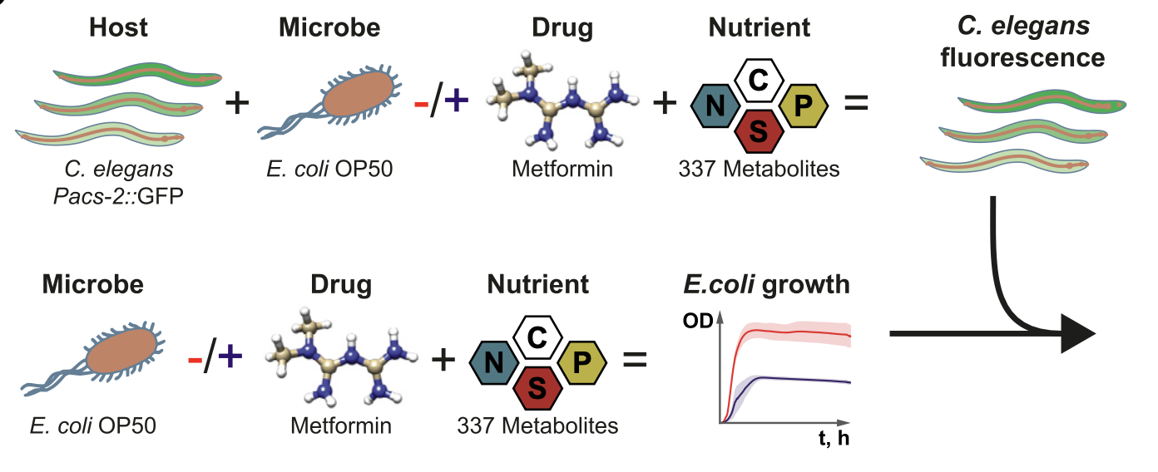
Introduction – bacterial effectors of metformin therapy

Slide 8
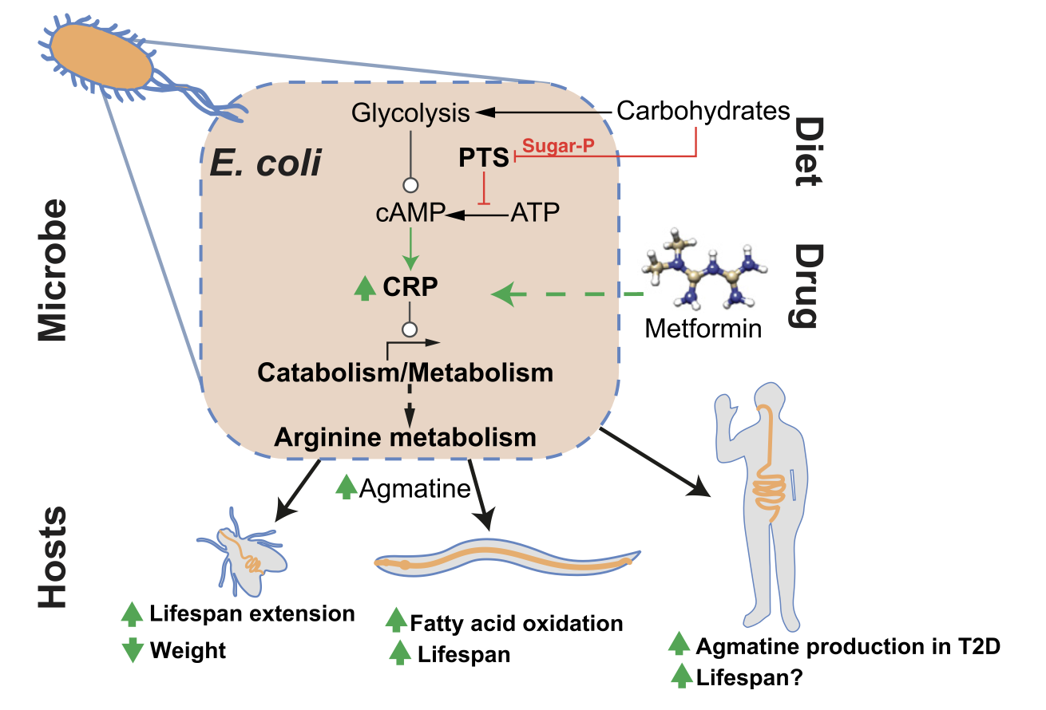
Introduction – bacterial effectors of metformin therapy

Slide 9
The Escherhichia coli pangenome collection
In the context of metformin treatment, is the host response dependent on the strain?
Are the effects linked to the differential metformin resistance between bacterial strains?
What are the bacterial drivers affecting the host response to the drug?
E. coli pangenome collection
153 pathogenic strains
19 laboratory strains
337 animal and human commensals
234 human gut commensals
6 uncharacterized strains
~750 strains
Genome sequence of all strains
Notes:
One of the main reasons to study this diversity is to scape from the laboratory strains, which cover a tiny bit of the E. coli species in the end

Slide 10
Worm and Strain phenotype with metformin

Slide 11
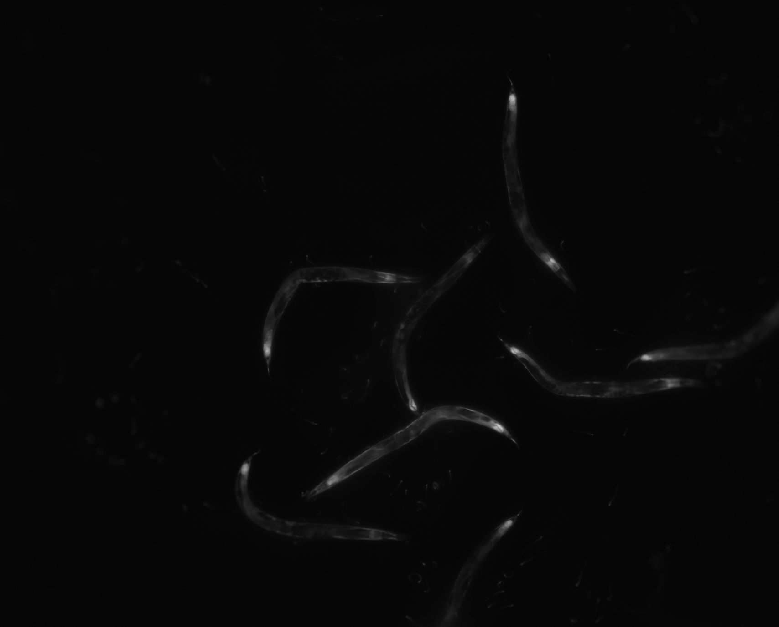
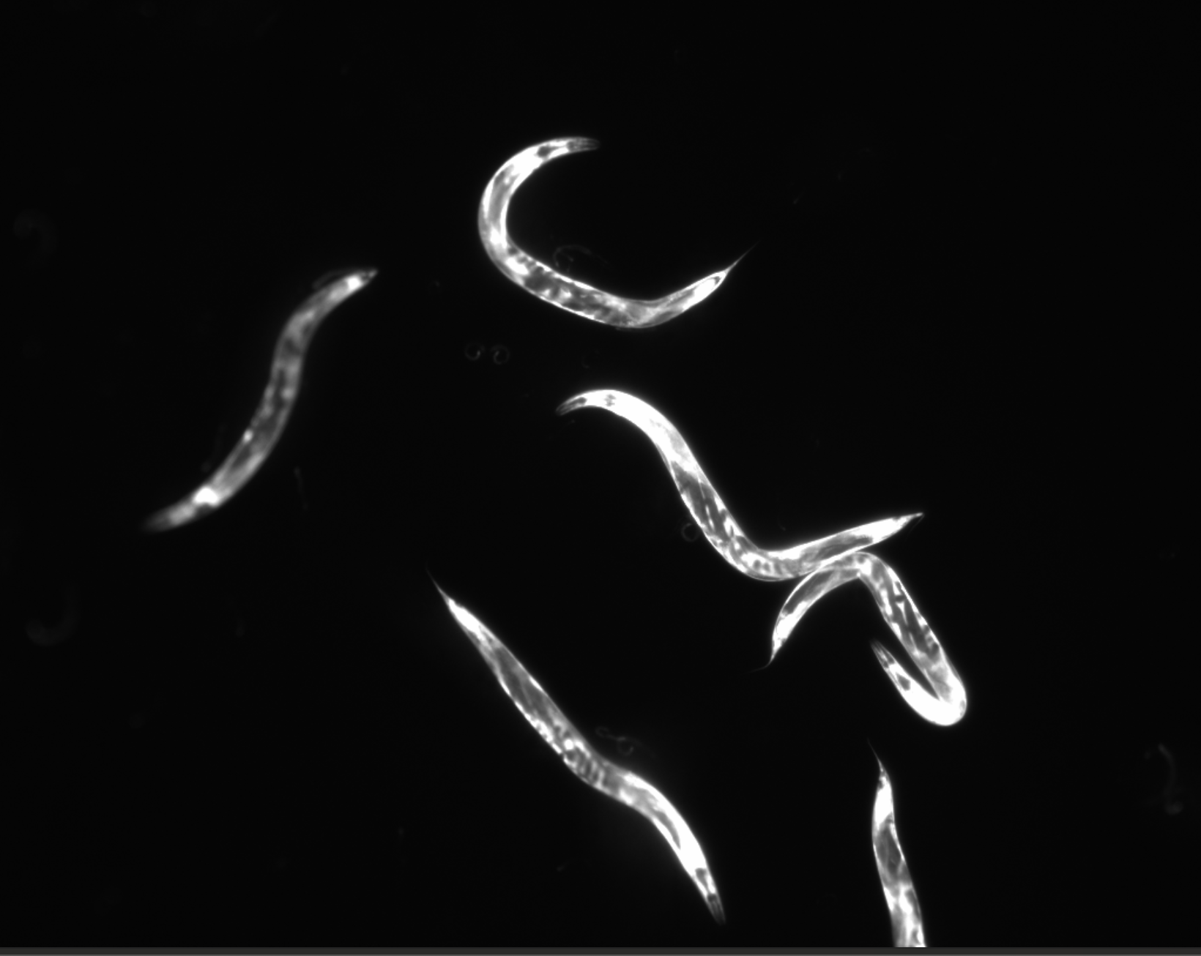
Using the worm as a readout for host-bacterial interactions
Promoter
acs-2 is used as our readout in the worm
Related to fatty acid metabolism, expression is higher in the presence of metformin.
GFP
acs-2
0 mM Metformin
50 mM Metformin

Slide 12
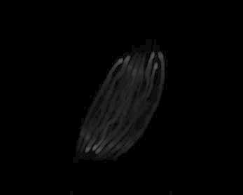

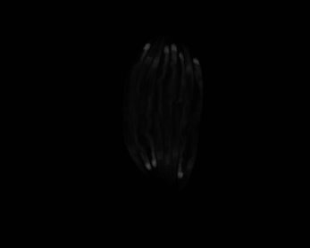
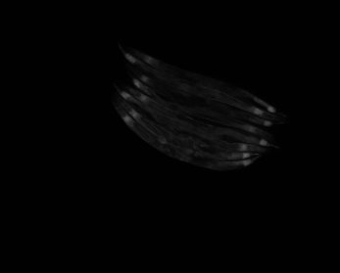

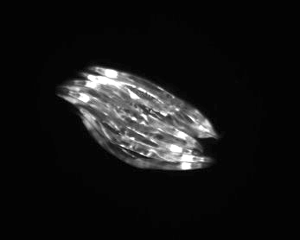

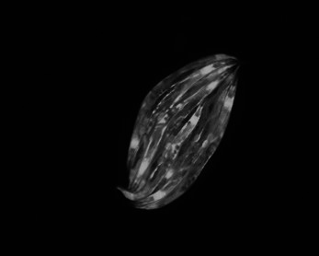








Different strains of E. coli have different effects on the host
0 mM
50 mM
OP50
Strain 1
Strain 2
Strain 3

Slide 13
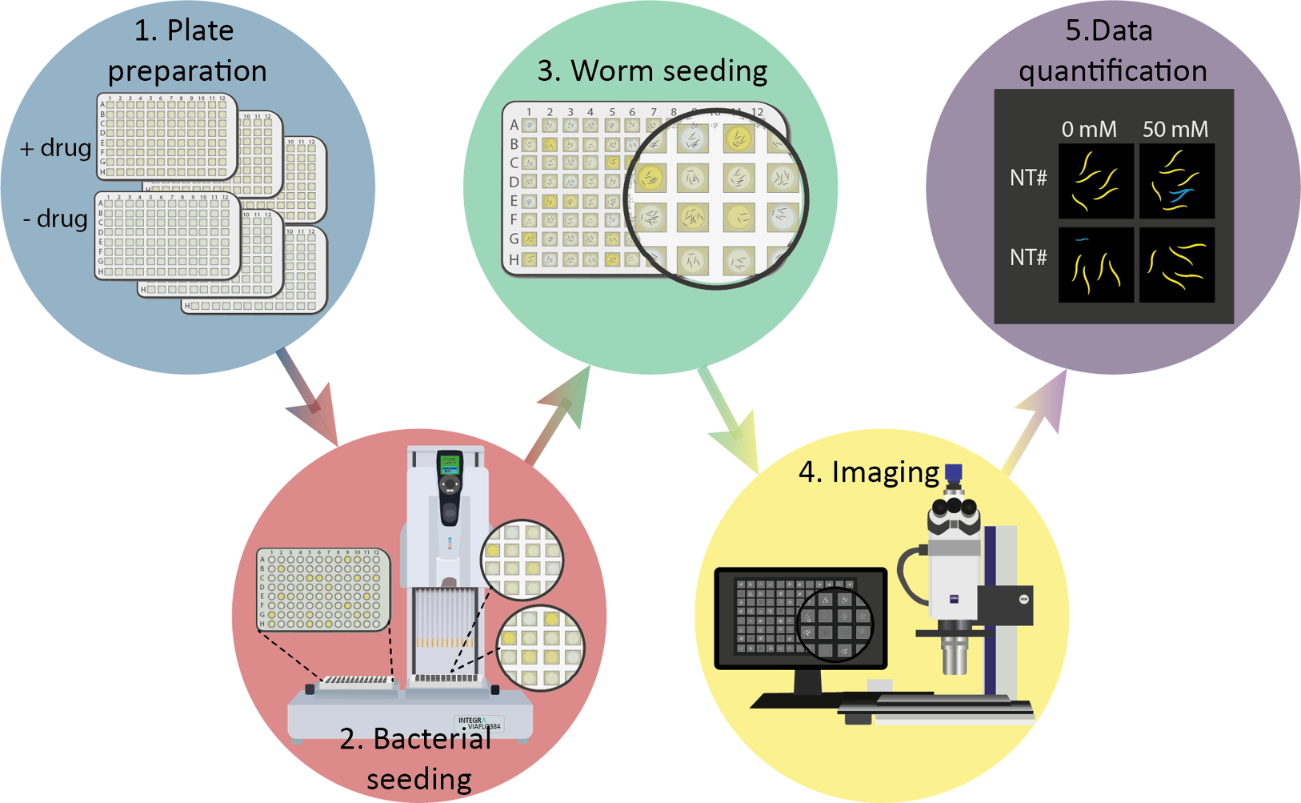
High-throughput Pacs-2::GFP C. elegans imaging​
Notes:
Automatization of the process

Slide 14
Different strains of E. coli have different effects on the host
Notes:
Change colors!

Slide 15
Using the worm as a readout for host-bacterial interactions
A strong strain-specific behaviour!

Slide 16
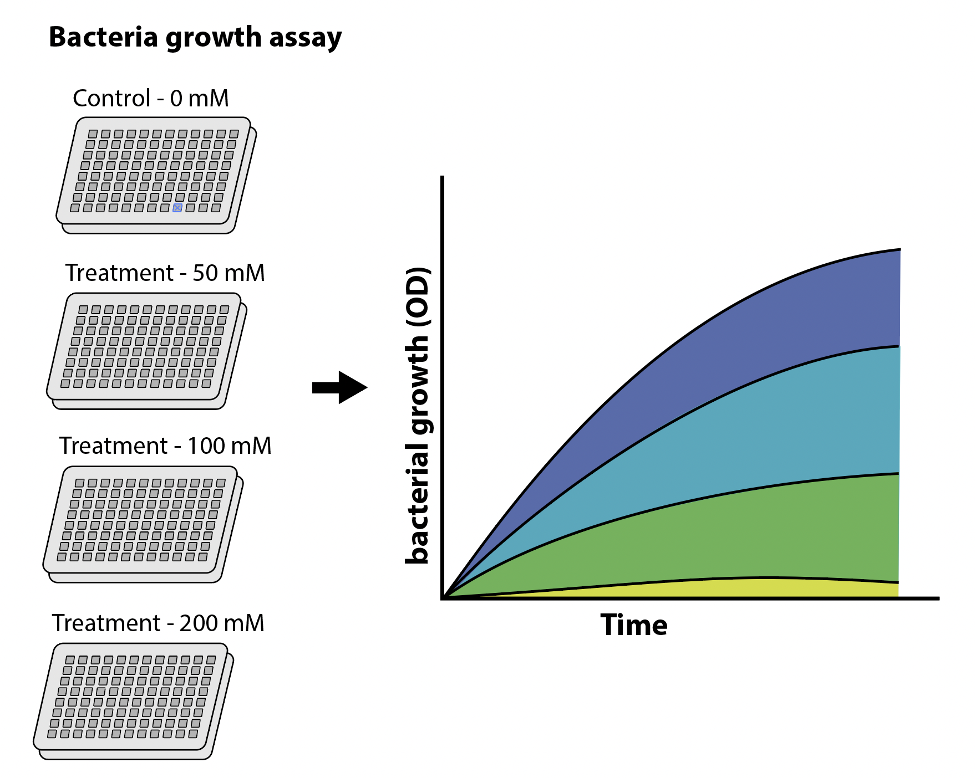
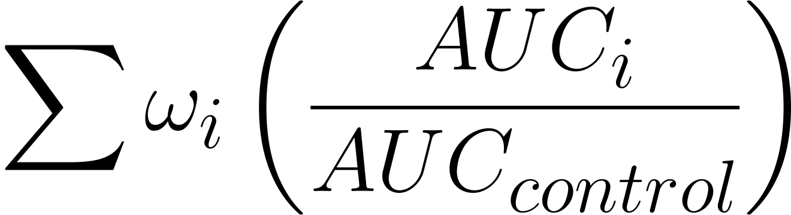
Bacterial growth phenotype
0 mM
50 mM
100 mM
200 mM
Resistance score

Slide 17
Bacterial growth phenotype – overview
A strong strain-specific behaviour!

Slide 18
Correlation of phenotypical traits

Slide 19
Let’s explore the genetic variability
Escherichia coli is known to harbour a large genetic diversity
It is considered to be an open pangenome
Brockhurst et al., 2019

Slide 20
E. coli pangenome shows a U-shaped distribution of gene presence
Accessory genome
Core genome
Category | Description | Genes
Core genes | (99% <= strains <= 100%) | 2774
Soft core genes | (95% <= strains < 99%) | 430
Shell genes | (15% <= strains < 95%) | 2553
Cloud genes | (0% <= strains < 15%) | 22119
Total genes | (0% <= strains <= 100%) | 27876
Notes:
In this slide we can see that, when we analyse this collection of the 750 strains, we have a total number of genes close to the 28K. The core genome is around 2800, plus about 430 genes present in almost all strains, leave ~24K genes that could be considered rare within the pangenome.
The metabolic capabilities of these strains can be greatly different in similar conditions. But how different?

Slide 21
Unravelling the complexity – sources of variation
PG collection
Worm phenotype
Metabolic capacity
Phylogroups
Bacterial phenotype
Genomic info
Annotation
Pangenome Calculation
gene P/A
gene variants
Structural variants
BGCs (biosynthetic gene clusters)
Prophages
Cryptic prophages
Plasmids
GFCs (Gene family clusters)
Sources of variation

Slide 22
The E. coli phylogenetic tree shows concordance with established phylogroups
B1
C
E
Phylogenetic tree from the core genome genes aligned
It shows a strong correlation with the previously known phylogroups of E. coli
A
D
G
F
B2

Slide 23
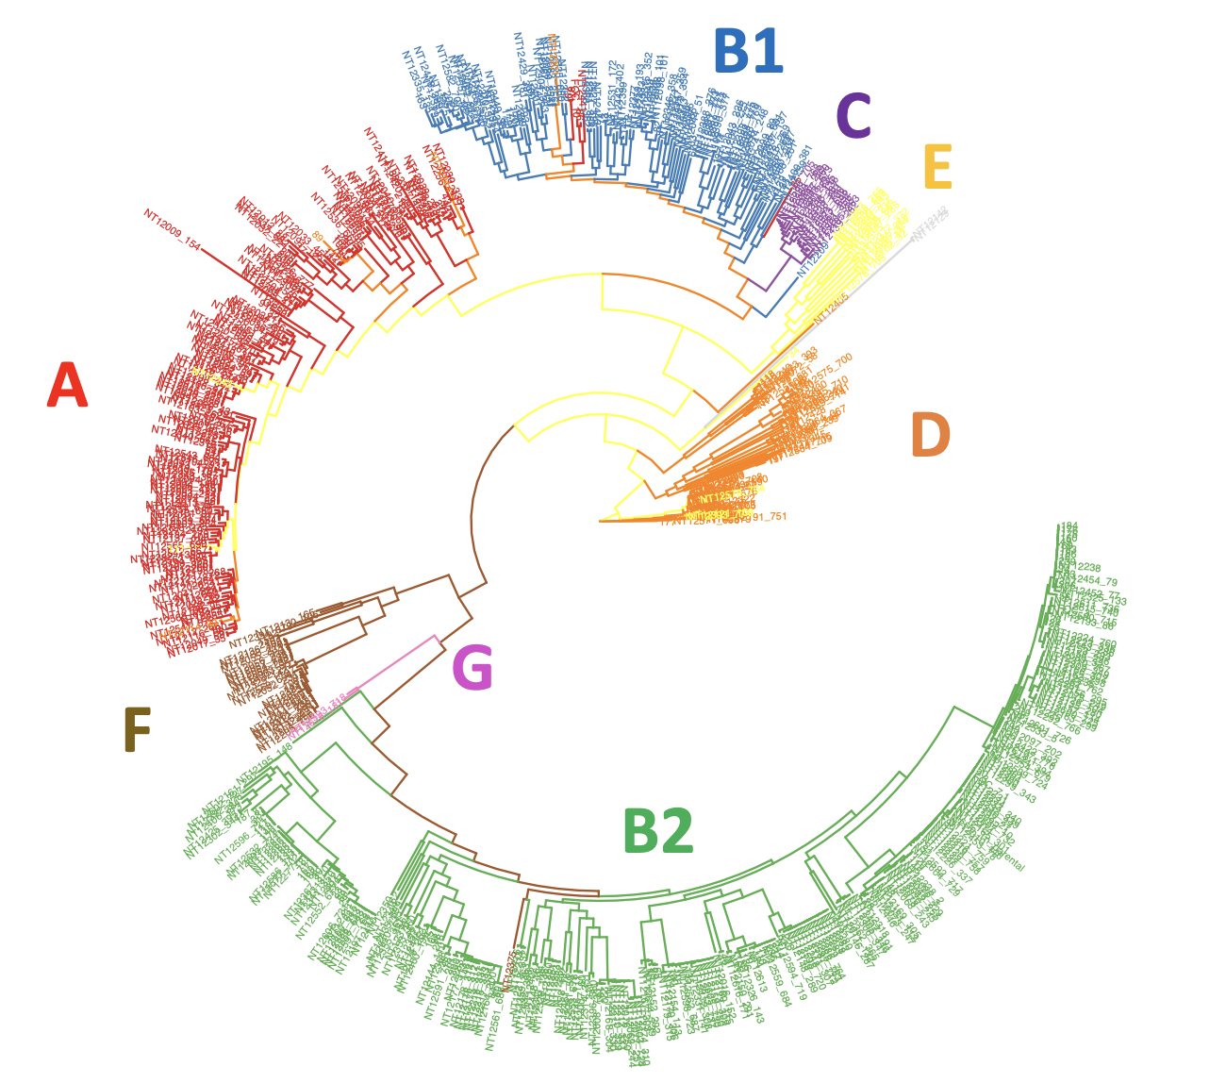
The E. coli phylogenetic tree shows concordance with established phylogroups
Gene P/A PCA plot
Phylogroups tree
F
D
E
B2
B1
C
A

Slide 24
Strain distribution across phylogroups and phenotype

Slide 25
Adding all the information together in a phylogeny shows some trends

Slide 26
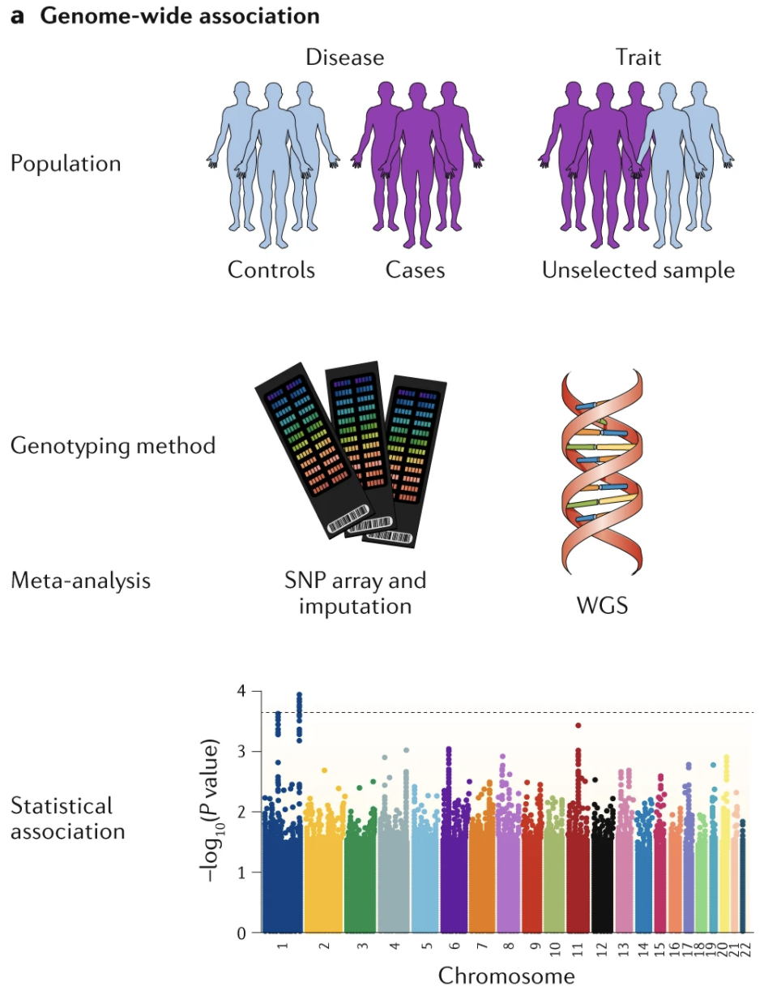
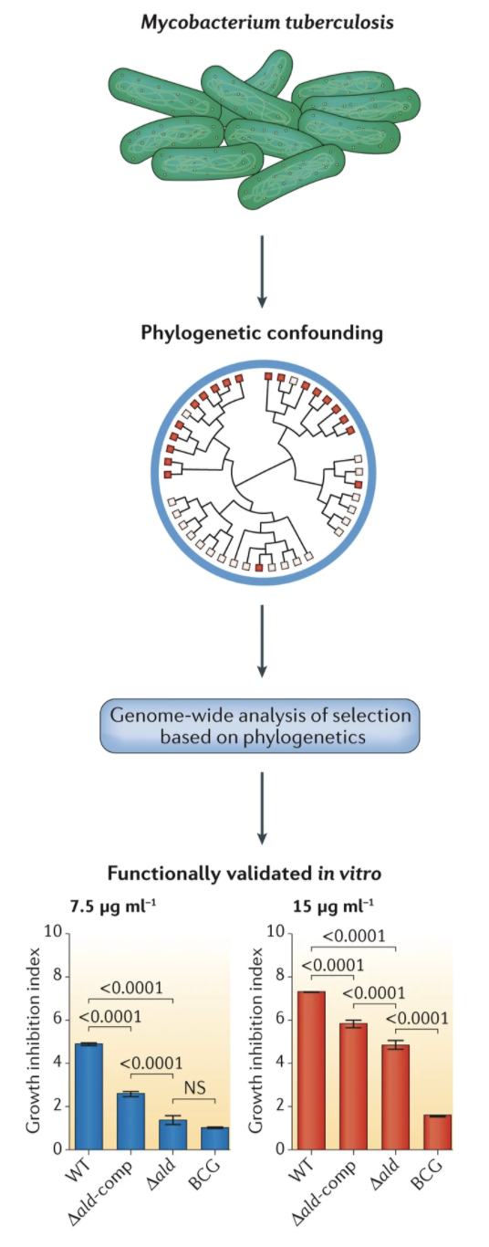
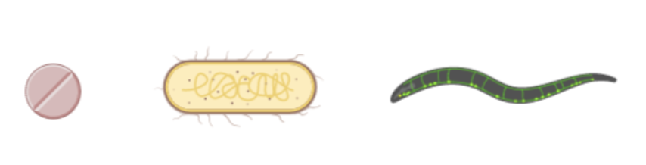
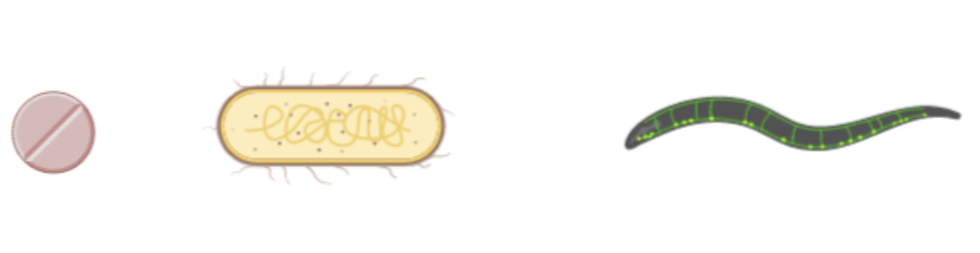
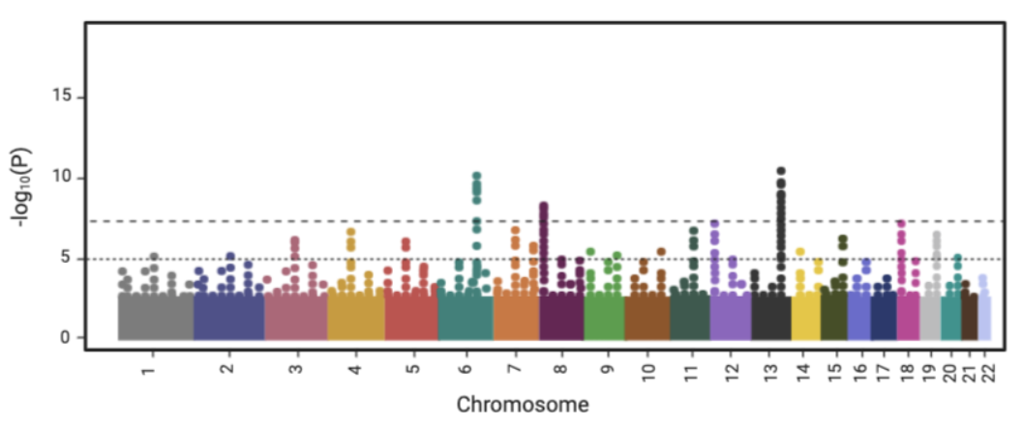
Microbial GWAS
GWAS
mdGWAS
mdhGWAS
Experimental Validation
(Tam V 2019, Nature Rev. Genetics)
(Power RA V 2016, Nature Rev. Genetics)

Slide 27
Genes in the accessory genome might be playing an important role
The accessory genome can be analysed by taking into consideration the presence or absence of genes that are strain specific.
Brockhurst et al., 2019

Slide 28
Microbial GWAS in the context of metformin
Presence/absence data can be used to understand how genetic variation can be linked to phenotype
Notes:
REDO PLOTS

Slide 29
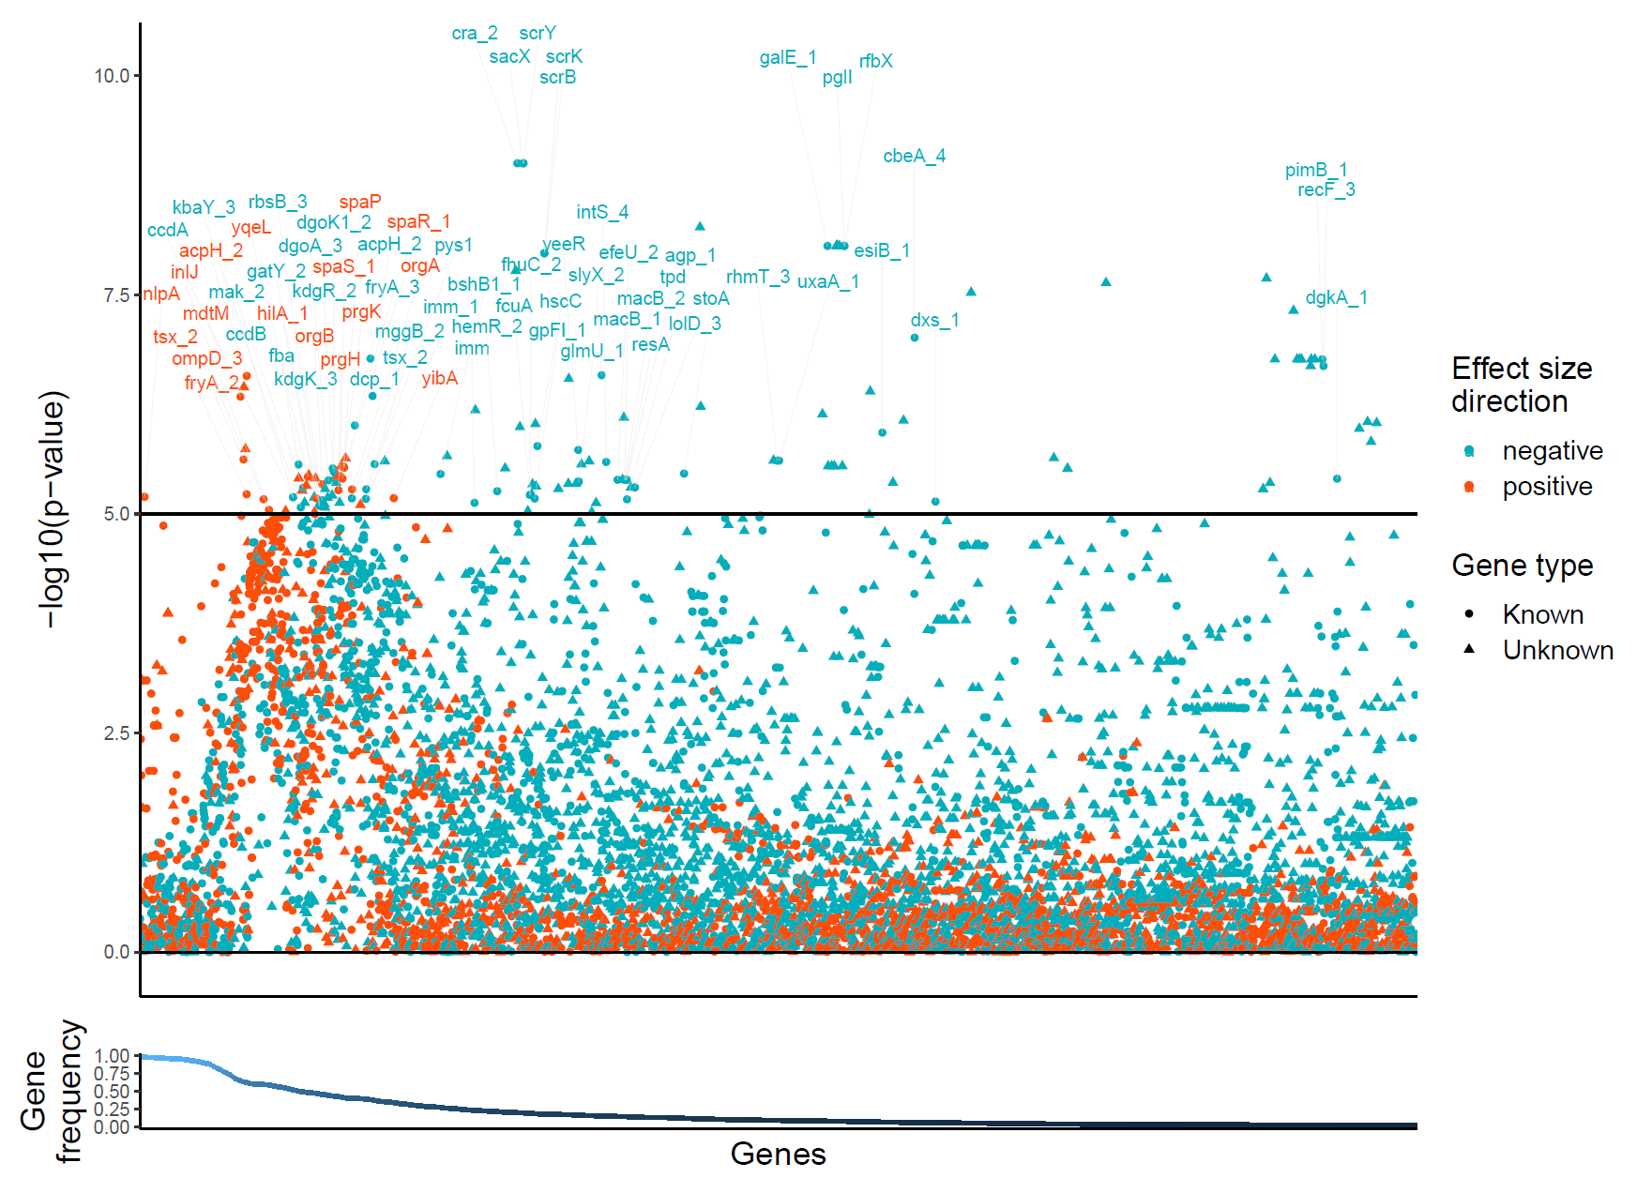
Microbial GWAS in the context of metformin
Notes:
REDO PLOTS

Slide 30
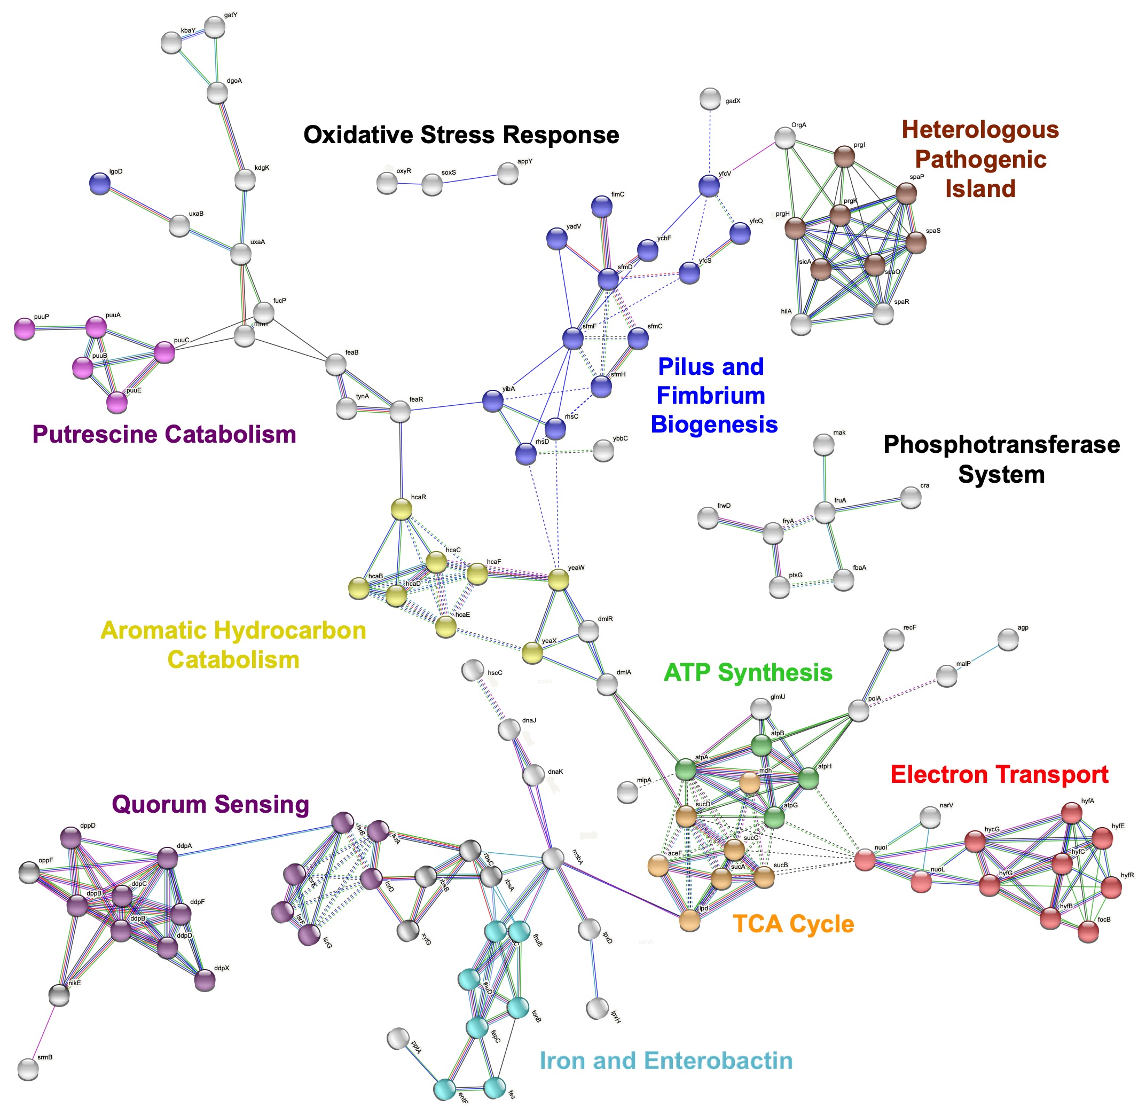
Microbial GWAS in the context of metformin
Enrichment analysis shows some potential bacterial pathways that may be acting in host response to metformin

Slide 31
E. coli core genome can be studied as well
The core genome can be analysed by taking into account the genetic variants that occur in the population (SNPs, structural variants, indels…)
Brockhurst et al., 2019

Slide 32
Exploring the unitigs (”k-mers”) of the pangenome
mdtB is a gene related to drug transport in the bacterial cell

Slide 33
Summary
We can summarise the findings in:
- E. coli strains have specific and differential effect on the host in the presence of metformin. Besides, they are a wide range of resistance to the drug in growth conditions
- Both phenotypes don’t show a trend in correlation
- E. coli has a wide and open pangenome with a large gene diversity
- This gene diversity seems to be pointing at some metabolic pathways and genetic modules that might be important for the bacterial role in the host response to metformin
- This work shows that the mechanisms present in the natural context can be very rich an diverse. Using the right animal model together with the right tools allow us to rapidly explore a vast and complex landscape

Slide 34


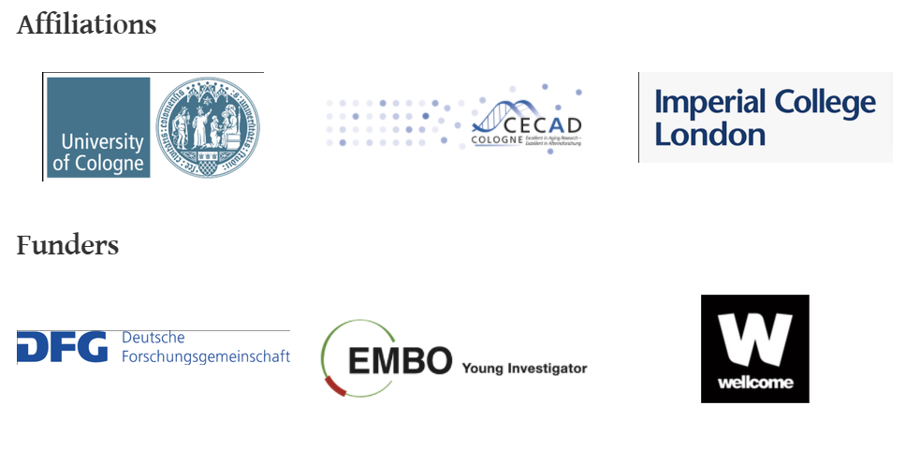
Cabreiro Lab
Many thanks to my colleagues!
Filipe Cabreiro (PI)
Jennifer van der Laan
(PhD student)
Dr. Tanara Peres
Dr. Cassandra Backes
Dr. Francesca Solagna
Kristin Gehling
Andreea Aprodu
Ayesha Safoor
Julie Schubert
Sophie Trappel

